Slide 1


Cocktails and Covid 19 Pounds: The Essential Ingredients for Early Cirrhosis in Women (and men)
Elyssa Del Valle, M.D. DBIM

Slide 2
Objectives
Discerning advanced liver fibrosis can be challenging and due to increasing prevalence of MASLD along with increased trends on alcohol use, we should expect early claims. In this session, we will explore the red flags at time of underwriting that should prompt high suspect for advanced liver fibrosis and thereby protect your business from early claims.
Trends on Metabolic associated steatotic Liver disease (MASLD) and Alcoholic Liver disease (ALD)
Cocktails and Covid 19 pounds: Ingredients for Early Cirrhosis in Women
Show and Tell: Bedside hospital rounds examining the sequelae of cirrhosis
Red Flags for high suspect for Cirrhosis via laboratory and imaging
An Early Claim
How hepatologists evaluate and determine treatment for MASLD
One Antidote
Notes:
trends not looking good for liver disease world wide. They may be falling for viral hepatitis, but you will see that overall,, things are getting worse. Half way into talk you will understand the title as women are at increasing risk. What I hope to point out is that we need due diligence in underwriting to look for the red flags that are not so easily seen unless you look for them As you will see, claims are going up, and thus, we need to pay closer attention to the details. I will help make that easier as I illustrate the pearls when we look at a typical claim.

Slide 3

Hello Fatty liver….
NOW referred to as: Metabolic dysfunction associated steatotic liver disease
MASLD
Associated with Metabolic Syndrome which is why fatty liver is the
#1 cause of liver disease in Western countries
Fatty liver has doubled over last 20 yrs with estimates of 30-38% in adults, Consistent with rise in metabolic syndrome such as obesity and diabetes
10-30% with MASLD have MASH (steatohepatitis)“itis” = inflammation”
and 25% of those will end up with cirrhosis
stats from WHO 2024 and CDC 2023
3

Slide 4
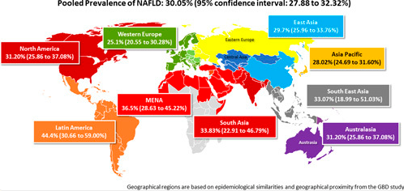
Prevalence of MASLD
Metabolic dysfunction - associated Steatotic Liver Disease
Hepatology 77 (4): 1335-1347 April 2023
4

Slide 5
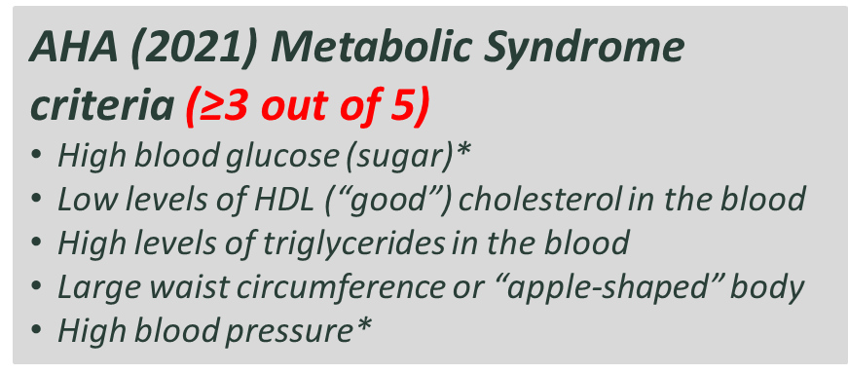
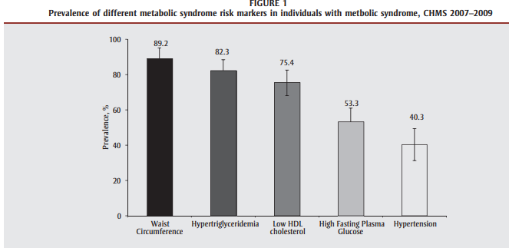
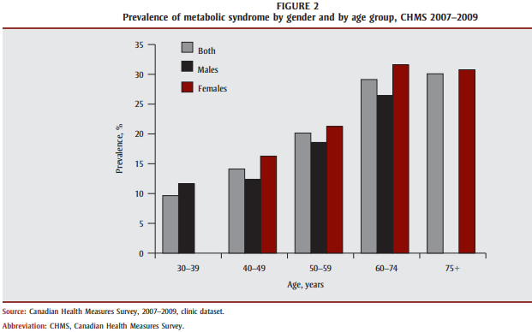
Prevalence of metabolic syndrome in Canada
Good example of breakdown of the criteria for MS – reveals adiposity, elevated trigs and low HDL as most common
Thought of another verse for Pete Seeger’s famous song: where have all the old men gone?
Metabolic syndrome and chronic disease, Deepa Rao et al
Vol 34, No 1, February 2014 Chronic Diseases and Injuries in Canada
Notes:
going to take one country as an example on prevalence. As this really depicts the prevalence of individual criteria

Slide 6
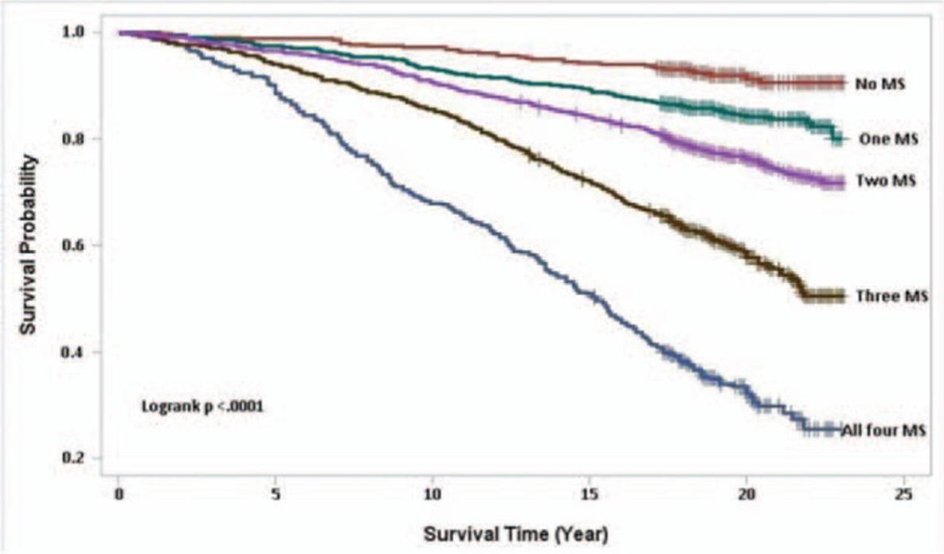
Components of metabolic syndrome and mortality for those with MASLD
did not include high trigs as component
Metabolic syndrome components included:
Diabetes: FBS > 126 mg/dl or use of antidiabetic meds
HTN: ≥140 mm Hg or diastolic blood pressure of ≥90 mm Hg from an average of 3 measurements, use of antihypertensive medication in the past month, or a history of high blood pressure
HDL < 2.2 mmol/L (40 mg/dl men and < 2.8 mmol/L (50 mg/dl) women
Central Obesity: waist circumference cut off points for White/Black >102 cm for males and >88 cm for females, and for Asians, >90 cm for males and >80 cm for females.
Hepatology 77 (4): 1335-1347 April 2023

Slide 7
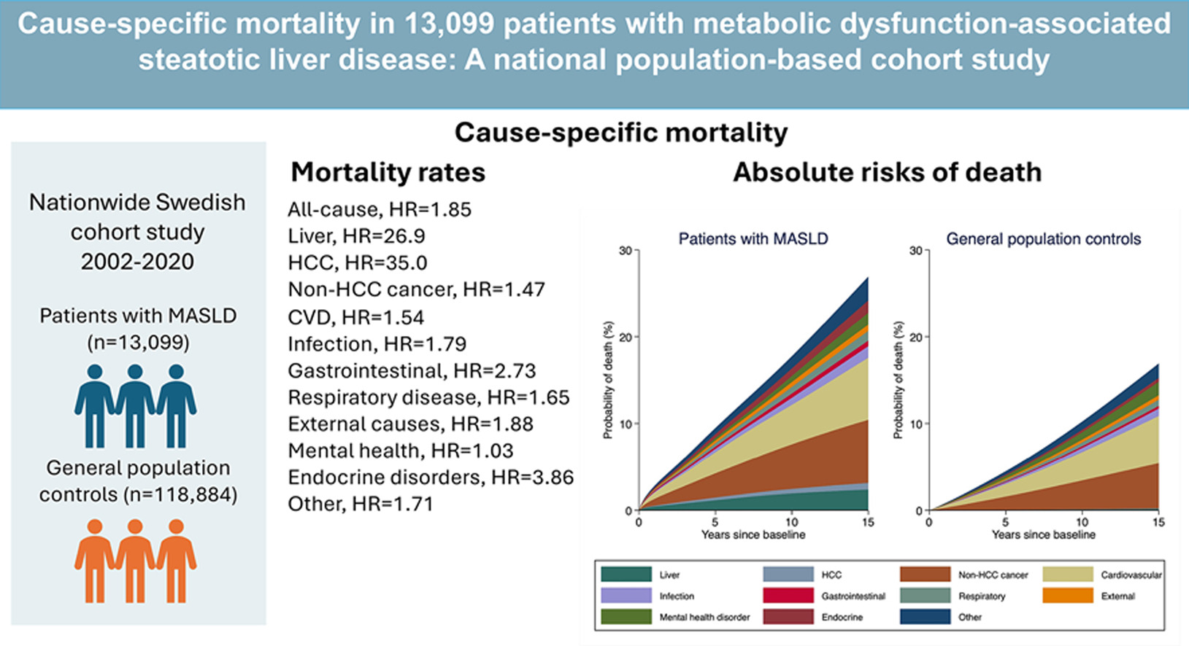
Cause specific mortality in a Swedish research published 24, March 2025 Gabriel Issa et al
Key insights
  all cause mortality was double in those with MASLD versus general population
  Cardiovascular disease, HCC and non-HCC cancers higher as cause of death in MASLD
  Need multidisciplinary care to reduce these premature deaths

Slide 8
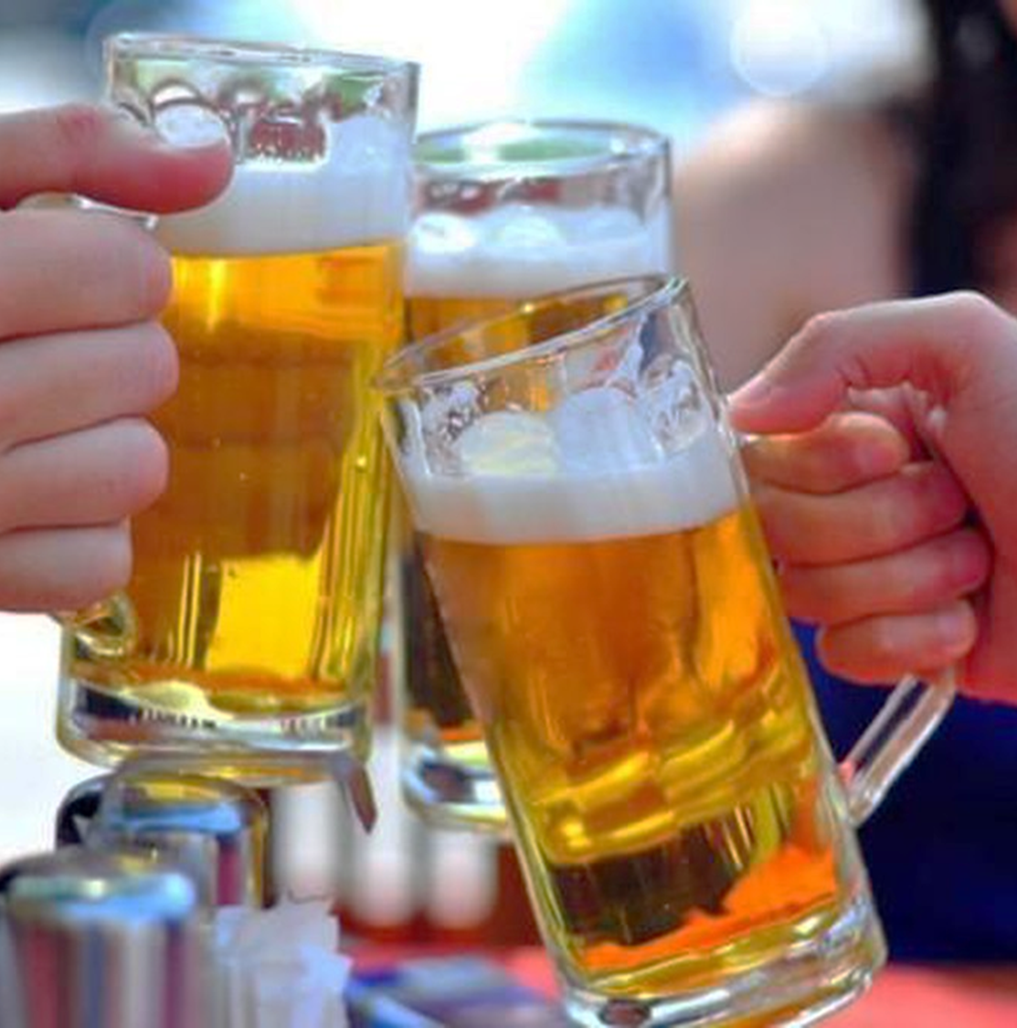
What about Alcoholic liver disease

Slide 9
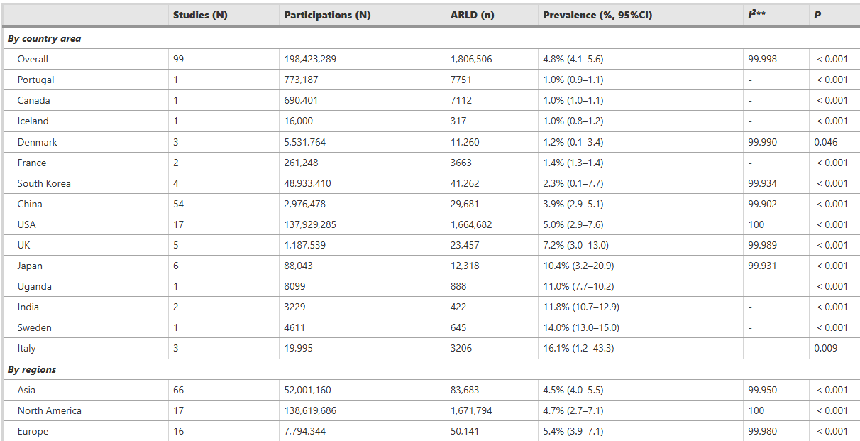
Alcohol induced liver disease related hospitalization and liver transplants surged over the past two decades. Overall prevalence is 4.8% of general population but up to 16% in some regions
BMC Public Health : Global prevalence, incidence and outcomes of alcohol related liver disease: a systematic review and meta-analysis 2023
Prevalence of
ALD
Estimated 10-35% of alcoholics have ALD
Netherlands fall around here at 3.5%
9
Notes:
pretty high given fact that less than half of alcoholics have ALD. so there must be lots of alcoholics in the world!!

Slide 10

Women Increasingly at Risk for Alcohol –Related Liver Disease.
Let’s explore why
Elyssa Del Valle, M.D. DBIM

Slide 11


Seems a whole new culture began since that HBO series aired - The Girl’s Night Outs

Slide 12
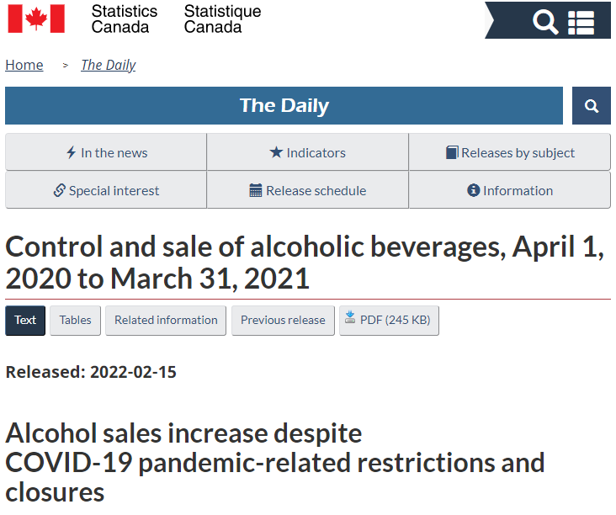
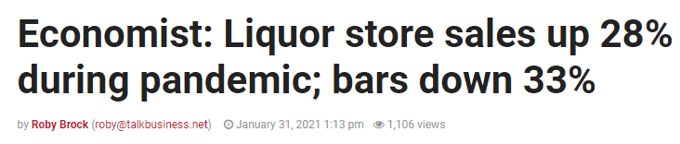
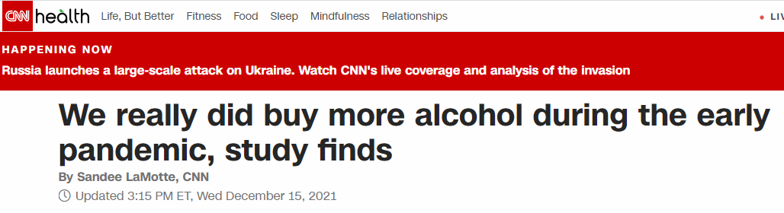

Slide 13



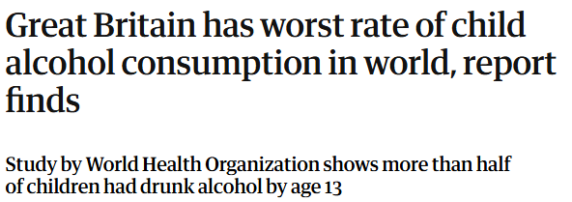
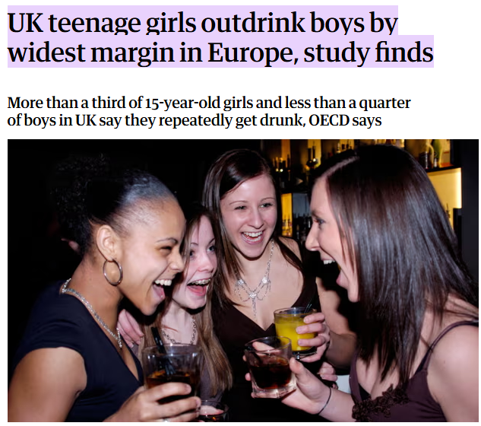
Setting the Stage on Alcohol Use Among Women
Per CDC:
  Half of adult women report drinking alcohol
  13% adult women report binge drinking and on average 4/month consuming 5 drinks per binge
  18% of women 18-44 binge drink
  in 2019, 32% of female HS students consumed alcohol compared to 26% of male HS counterparts and binge drinking 15% as compared to 13% of HS students
  In 2019, 4% of women overall and 8% of those age 18-25 had an alcohol use disorder

Slide 14
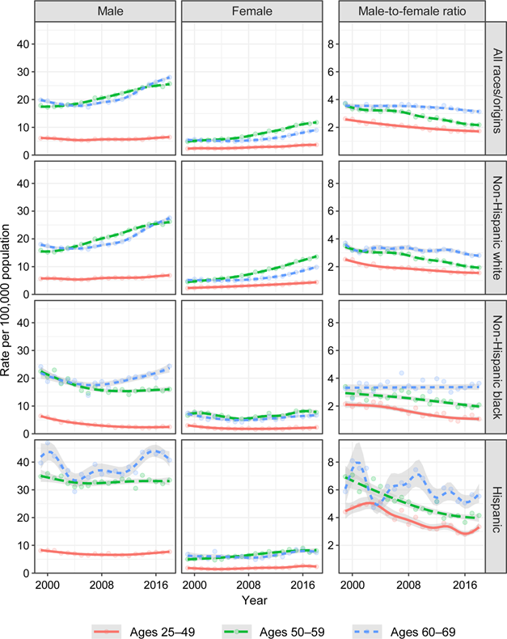

Data that sounds the Alarm
Make no mistake; Alcohol deaths continue to be greater in men than women – women just catching up… in a bad way
Trends in Premature Deaths from Alcoholic Liver disease in US, 1999-2018
Young-Hee Yoon PhD et al. American Journal of Preventive medicine Volume 59, Issue 4 Oct 2020

Slide 15
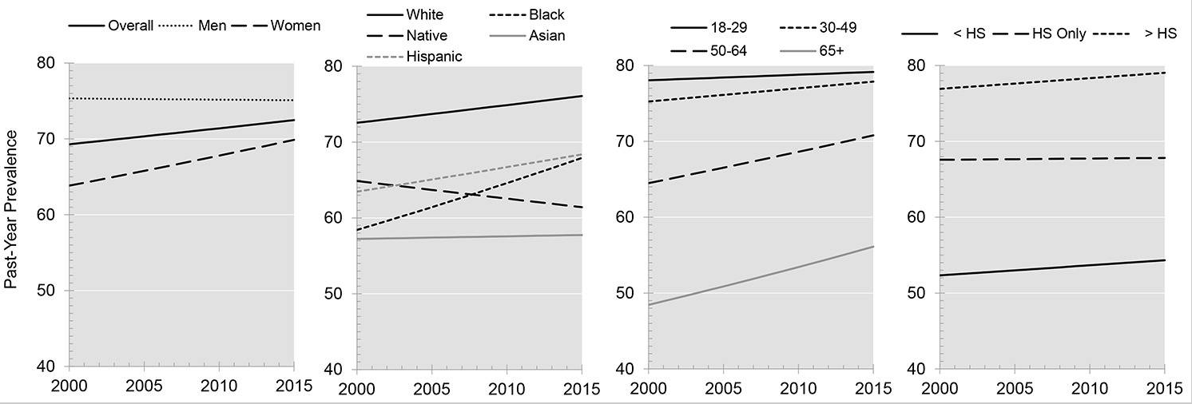
More Data to Sound an Alarm
Trends in Adult Alcohol Use and Binge Drinking in the Early 21st Century United States: A Meta-Analysis of Six National Survey Series
Conclusion: Number of women 18 and older who drink each year rose by 0.6% each year as well as number of women who binge drink. Gaps in alcohol related harm between men and women is narrowing – A Cause for ALARM
Alcohol Clin Exp Res. 2018 Oct; 42(10): 1939–1950.

Slide 16
Few Stark Conclusions
Largest increase in Alcoholic liver disease is in women ages 25-34
Typically takes 10 or more years of drinking to develop liver disease, thus a concern if seeing premature mortality from liver disease in ages under 35
Women dying from ALD 2-3 yrs earlier than men
Alcoholic liver disease and MASLD are the leading causes requiring liver transplantation, which had been stable for 3 decades until now
The global rate of liver transplants doubled over the last 2 decades with only 10% of patients needing one, receive one. USA performs the highest number followed by China and Brazil
WHY ARE WOMEN MORE SUSCEPTIBLE ?
Notes:
so I think I have convinced you all that alcohol misuse has gone up and especially in women… and the more educated, the more the misuse.. without them even realizing it.

Slide 17
Susceptibility factors in women
What makes women more susceptible to adverse effects of Alcohol?
  Rise in alcohol misuse – higher occurrence of alcoholic hepatitis
  Higher levels of endotoxins from gut bacteria found in women compared to men after one single episode of binge drinking
  Alcohol boosts the permeability of gut endotoxins and bacteria to enter bloodstream, triggering inflammation in liver and elsewhere
  Theory that women have less water in their bodies than men (leads to smaller volume of distribution) which causes higher concentration of alcohol in blood, with greater harmful levels of exposure to organs
  Women absorb more alcohol and take longer to metabolize it and thus, the immediate effects occur more quickly and last longer than in men.
  Increase Kupffer cell activation with estrogens which leads to cytokine release and inflammation
  Women have lower levels of cytochrome P4502E1, important for EtOH metabolism

Slide 18

Cocktails and Covid 19 Pounds: The Essential Ingredients for Early Cirrhosis in Women
Alcohol
+
Covid 19 Pounds ( component of Metabolic Syndrome)
=
Met ALD

Slide 19
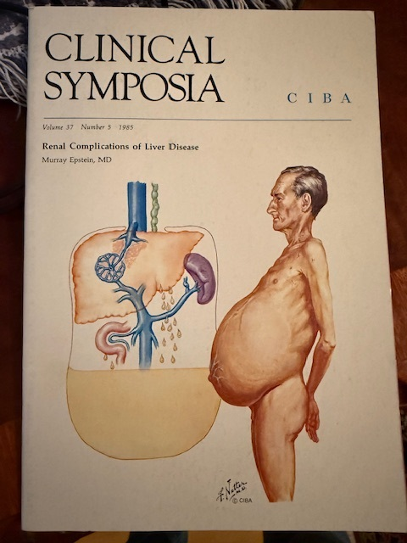
Everything you want to know about Cirrhosis but were afraid to ask!
So am going to show you!!

Slide 20
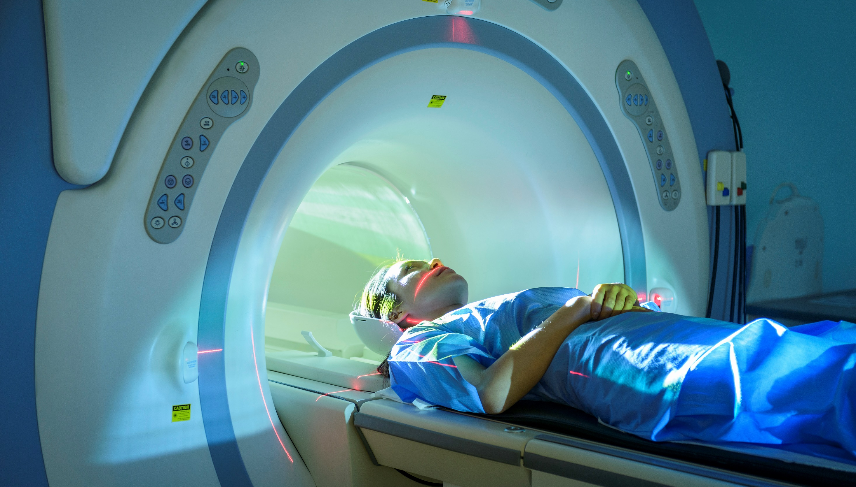
  Liver Cirrhosis: Complications
Ascites
Hepatic encephalopathy
Hepatorenal syndrome
Variceal hemorrhage
Spontaneous bacterial peritonitis
Hepatocellular carcinoma
Hepatopulmonary syndrome
No way to reverse these late stages of Cirrhosis Decompensation
Only treatment at late stage is Liver Transplantation
And here come the CI Claims
20

Slide 21
Stigmata of Liver Disease
Physical Exam Findings at the Bedside
Please join me on hospital rounds
Elyssa Del Valle, M.D.
21

Slide 22
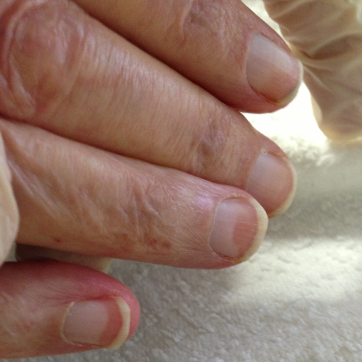
Terry’s Nails
22

Slide 23
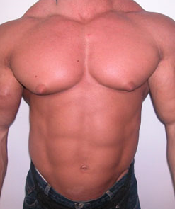
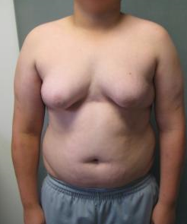
Can you guess which depicts gynecomastia due to liver cirrhosis
23

Slide 24
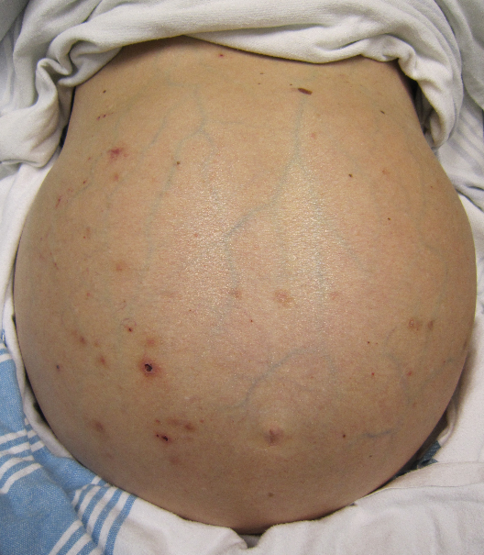
Ascites
24

Slide 25
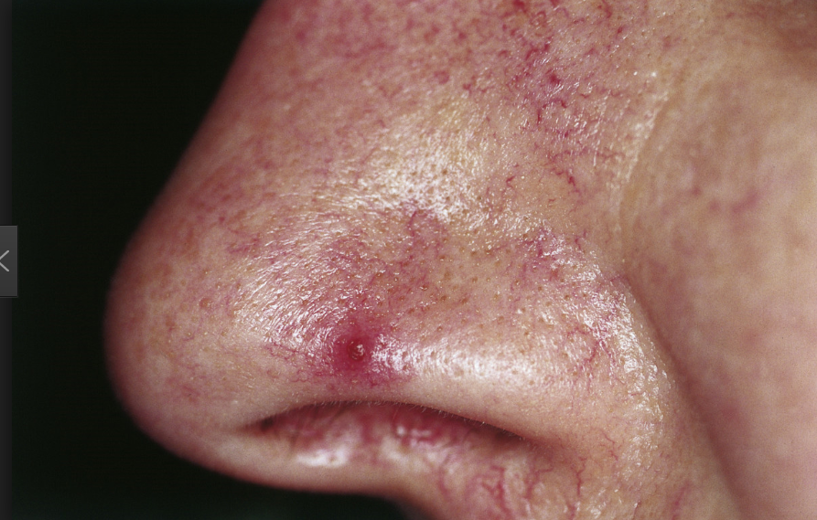
Spider Nevi or Facial
Telangectasia
25

Slide 26
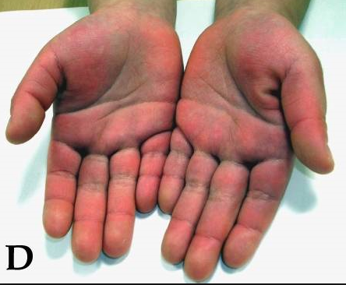
Palmar
Erythema
26

Slide 27
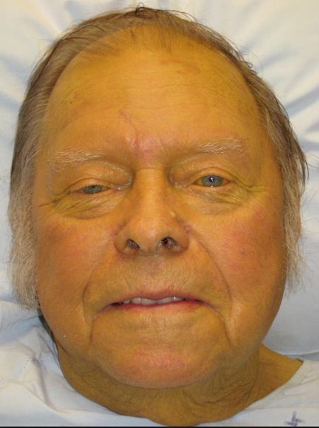
Jaundice
27

Slide 28

Pop question
What sequela of cirrhosis does this depict?
wikwikipedia

Slide 29
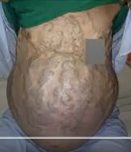
Caput medusa
Distended abdominal veins
CAPUT MEDUSAE: Causes- Risk factors- Meaning- Symptoms-Treatment- Palm Tree Sign - YouTube

Slide 30

William Bean’s poem on Spider nevi
“An older Miss Muffett…
…Decided to rough it…
…And lived upon whisky and gin.”
“Red hands and a spider…
…Developed outside her –
…Such are the wages of sin.”
Bean studied spider nevi extensively and noted its association with alcoholic cirrhosis. He was a British physician of the 19th century
Elyssa Del Valle, M.D.
30
Notes:
William Bean

Slide 31
Red Flags that suggest liver failure
Lab Tests: The Real Liver Function Tests
  Low Platelets
  Low Albumin
  Elevated INR or Protime
  FibroTest/Fibrosure scores 0-1 give degree of fibrosis
  Fib – 4 (first line tool for risk stratification in those with chronic liver disease of any type)
Imaging suggesting Liver Disease
  Abdominal Ultrasound with increased echogenicity suggests steatosis
  CT with hypoattenuation suggests steatosis
  FibroScan gives degree of fibrosis stage and CAP (controlled attenuation parameter) gives degree of steatosis

Slide 32

Case
40-year-old businesswoman applying for 1.2 million Euros whole life policy

Slide 33
Case
Application questionnaire: Last office visit 1 year ago for routine medical. Note indicated no concerns, blood sugar high normal and given mother has DM, she was advised to watch diet.
Admits 1, occasionally 2 glasses wine most days; occasionally will have 2 cocktails on girl’s night out
MVR remote DUI 18 years ago when age 22. RX neg, Medical records not requested
5’7” (170 cm) 220 lbs (99.7 kg) 125/72, T Chol 220 mg/dL (5.7 mmol/L) , HDL 75 mg/dL (4.2 mmol/L), Trigs 165 mg/dL (9.2 mmol/L), LFTs - AST 68 IU/L, ALT 41 IU/L, Albumin 36 g/L, A1C 6.1 % , HOS neg for proteinuria
UW decision: Small rating due to build and A1C – 150%
Christina Kutarna, Christina McWatt, Elyssa Del Valle, M.D. | Claim Forum Sep 2022

Slide 34
What transpired on this apparently healthy 40-year-old ?
34

Slide 35
The Claim
Insured died of liver cirrhosis 1.5 years after the policy was issued
35

Slide 36
Claim Investigation
No alcohol criticisms until post-issue
36

Slide 37
Our 40-yr old businesswoman
Any missed red flags upon underwriting??
Last office visit 1 year ago for routine medical, no concerns, blood sugar high normal, FHX DM, told to watch diet
Admits 12 drinks per week; remote DUI
Paramed bloods: T Chol 220 mg/dL (5.7 mmol/L) , HDL 75 mg/dL (4.2 mmol/L), Trigs 165 mg/dL (9.2 mmol/L), LFTs - AST 68 IU/L, ALT 41 IU/L, Albumin 36 g/L, A1C 6.1 %
Upon further review of that 1 yr ago visit
  LFTs - AST 77, ALT 52, Albumin 36, A1C 6.2
  CBC MCV 110, Platelets 125 x 10⁹/L, HDL 95 (2.46 mmol/L)
37

Slide 38
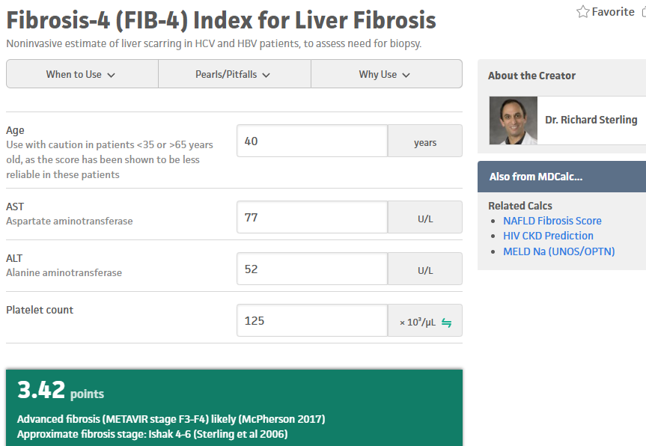
Calculate a Fib-4 on this 40-year-old female
Platelets 125,000
ALT 52
AST 77
Thoughts????? Any one wish to make a comment
Fibrosis-4 (FIB-4) Index for Liver Fibrosis

Slide 39
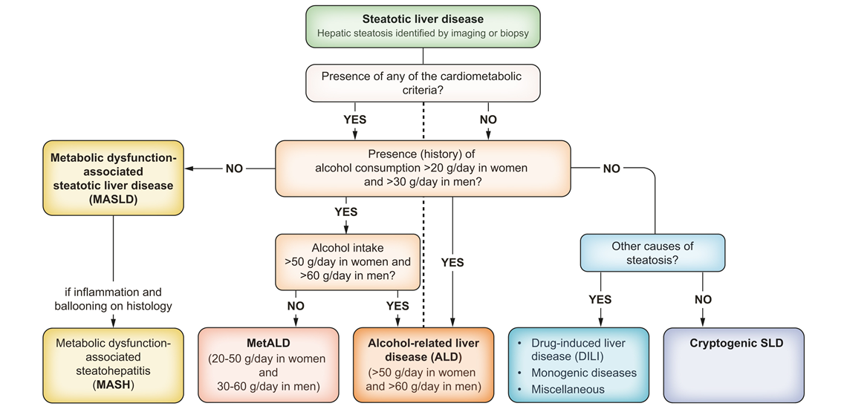
How does a hepatologist evaluate and treat MASLD that is identified by imaging or biopsy?
EASL clinical guidelines on the management of metabolic dysfunction-associated steatotic liver disease Journal of Hepatology

Slide 40
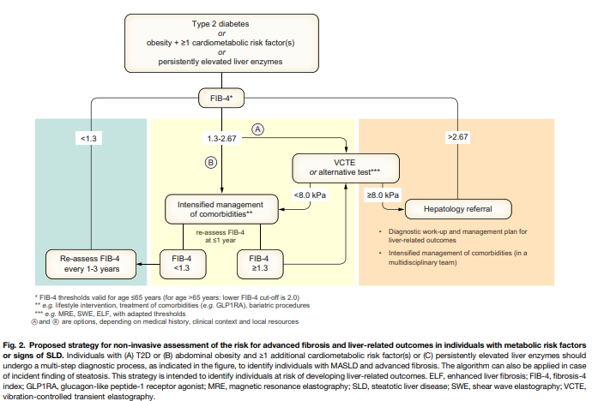
Next step, how bad: Fib 4?
Age
AST platelet count
ALT
clinical practice guidelines
The formula for FIB-4: Age ([yr] x AST [U/L]) / ((PLT [10(9)/L]) x (ALT [U/L])(1/2)).
Fib 4 > 3.25 is advanced liver fibrosis

Slide 41
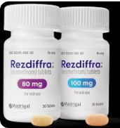


Treatments
Lifestyle: Control the metabolic conditions via life- style, exercise, weight loss (recall the slide on survival based on number of metabolic conditions)
Resmetirom – FDA approved for MASH – thyroid hormone receptor beta agonist – increases breakdown of fat in liver and reduces inflammation
Tirzepatide – GLP 1/GIP drug
COFFEE

Slide 42


The Antidote

Slide 43

My 2 cents on Coffee
Coffee !!!!!
At least 2 cups a day of the real deal, NOT decaf and not caffeine as in Coca Cola
Reduces development of liver fibrosis by 50%
Improves insulin sensitivity
This is per EASL data and evidence based per Dr. Sanjiv Chopra of Harvard Medical School and editor in chief of the hepatology section of Up To Date
&
BMJ 2017 Meta-analysis
43

Slide 44
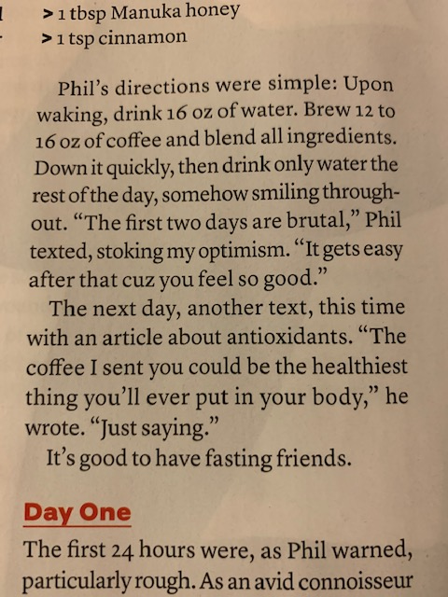
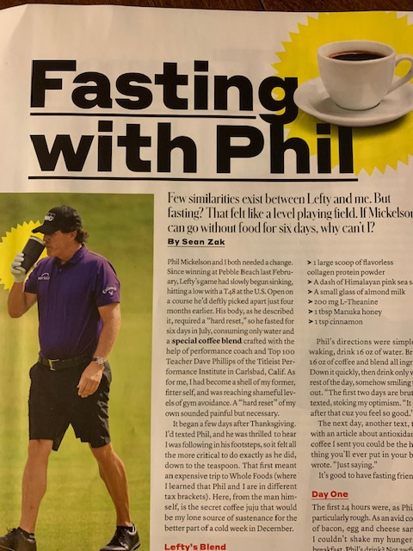
Phil Mickelson Is On the Correct Side of Coffee – Chopra’s Side!!!

Slide 45


Tallon Griekspoor
Arantxa Rus
Play Tennis
Drink Coffee

Slide 46

Any questions?
Elyssa Del Valle MD, DBIM
46

Slide 48
Legal notice
©2025 Swiss Re. All rights reserved. You may use this presentation for private or internal purposes but note that any copyright or other proprietary notices must not be removed. You are not permitted to create any modifications or derivative works of this presentation, or to use it for commercial or other public purposes, without the prior written permission of Swiss Re.
The information and opinions contained in the presentation are provided as at the date of the presentation and may change. Although the information used was taken from reliable sources, Swiss Re does not accept any responsibility for its accuracy or comprehensiveness or its updating. All liability for the accuracy and completeness of the information or for any damage or loss resulting from its use is expressly excluded.

